Slide 1
Financial Modeling Introduction

Slide 2

Financial Modeling Introduction
Historical Prices (2017 – YTD)

Slide 3
What is Financial Modeling?
The task of building an abstract financial representation of real world financial data.
Why is it helpful/necessary?
It helps narrow down large data sets and condense them into one simple spreadsheet that can be used as a template for gaining relevant insight into a company’s performance.

Slide 4


Where can one find the financials (proforma) for a publicly traded company?
Yahoo Finance
The Wall Street Journal
The investor relations section of the corporation’s website

Slide 5
What tools will we be using?
Microsoft Excel
Visual Basic for Applications (VBA)

Slide 6
This historical pricing data was imported directly from Yahoo Finance into Excel
Once any set of data is in Excel it is EASY to manipulate it by removing or expanding what is already there
For example, we can add % changes in prices over time and averages
Adding these statistics involves the use of formulas
However, removing irrelevant data can be done by hiding or deleting columns and/or rows.

Slide 8
Excel has many built in formulas, but we may (time-permitting) focus on the select few:
% Change (aka delta)
Average/ mean/ median/ st. dev
Vlookup/ hlookup
Countif(s), counta
SUM, SUMIFS
NPV, PV, IRR

Slide 9
Calculating % Change in Excel:
Example:

Slide 10
Calculating % Change in Excel:
Example:

Slide 11
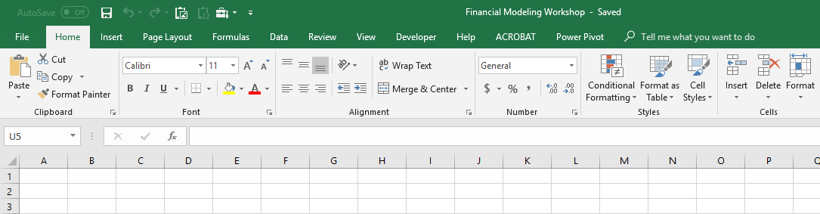
Before we proceed with more built-in Excel formulas, let us delve into a little bit of VBA (Visual Basic for Applications)
VBA is the back-end programming language of Microsoft Excel and other Microsoft Office programs.
It is important to ensure that our Microsoft Excel package has the Developer Tab added onto it.
This step is NOT mandatory for entering the visual basic editor, but is necessary if you are recording macros to automate various processes.
If you are just writing code (i.e. coding a function), you can enter the VBA environment simply by pressing ALT + F11 on your keyboard

Slide 12
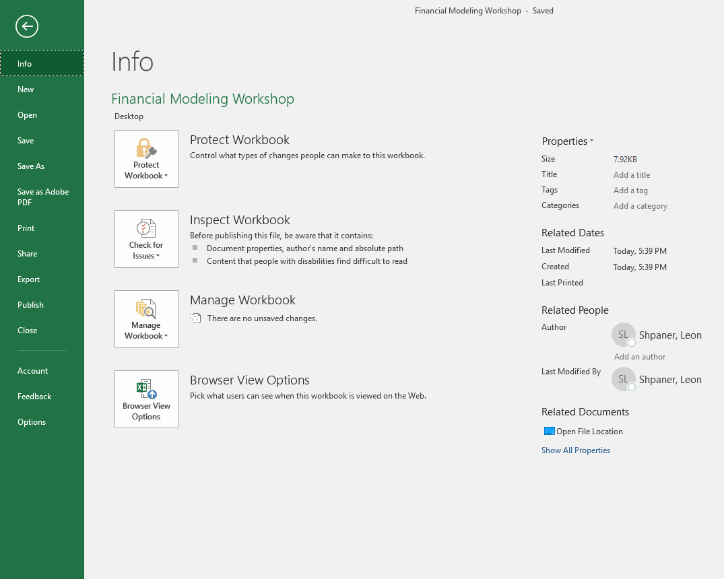
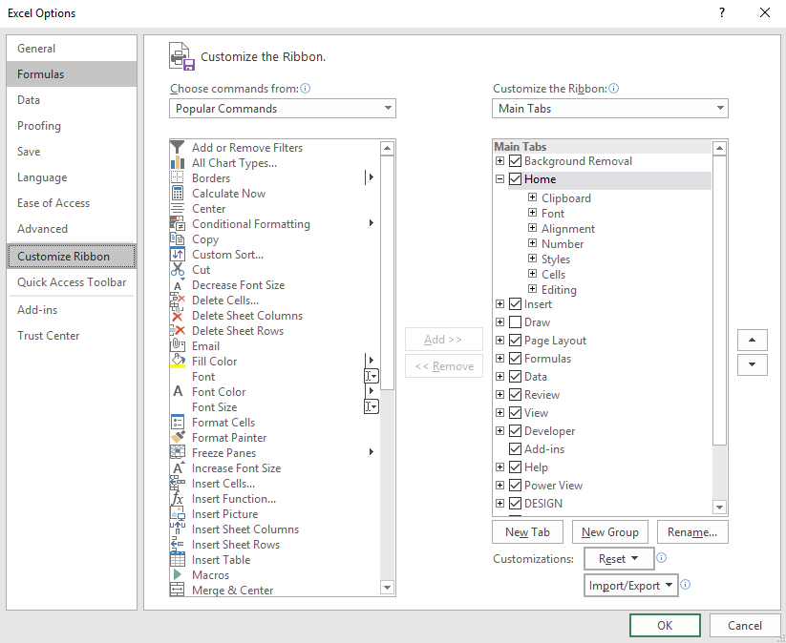
1. Click on “File”
2. Click on “Options”
3. Click on “Customize Ribbon”
4. Make Sure there is a check mark next to “Developer”

Slide 13
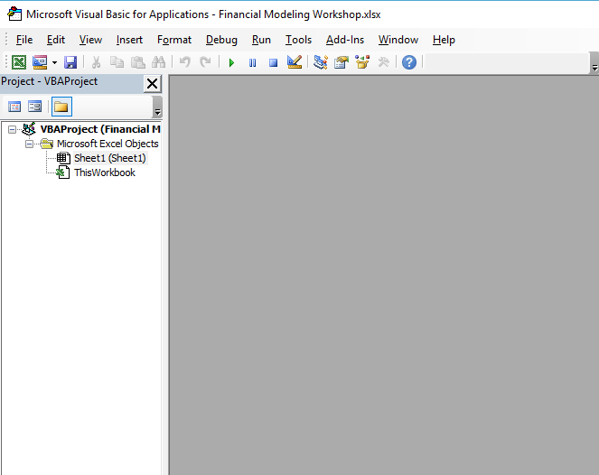
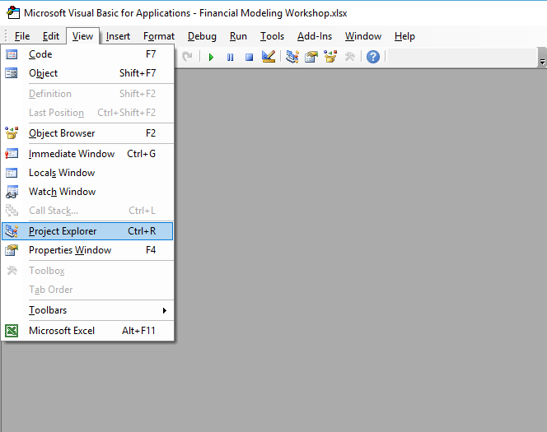
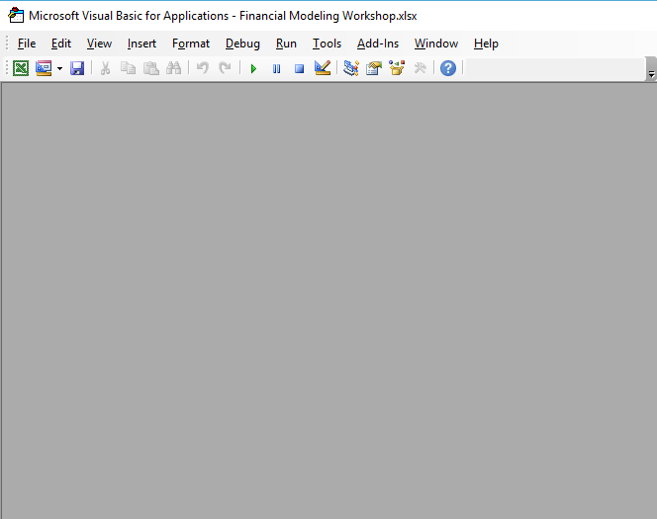
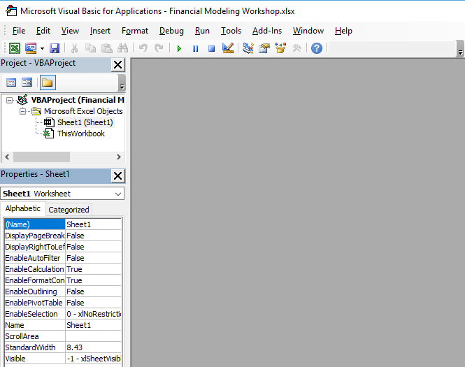
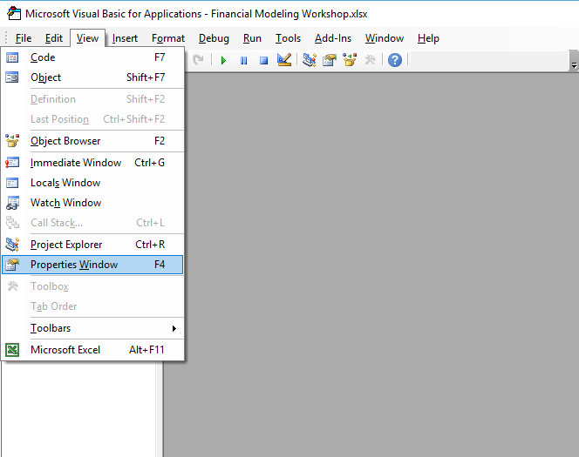
Now let’s finally pop open the VBA editor
Let’s go ahead and get accustomed to using shortcuts, so let’s punch in ALT + F11 on our keyboards
Let’s ensure to enable our “Project Explorer“ by clicking on view, and selecting “Project Explorer.”
Let’s ensure to enable our “Properties Window“ by clicking on view, and selecting “Properties Window.”

Slide 14
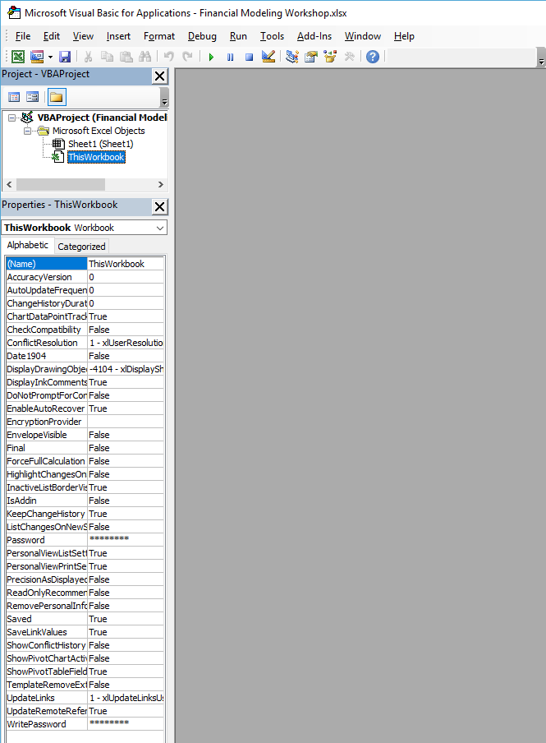
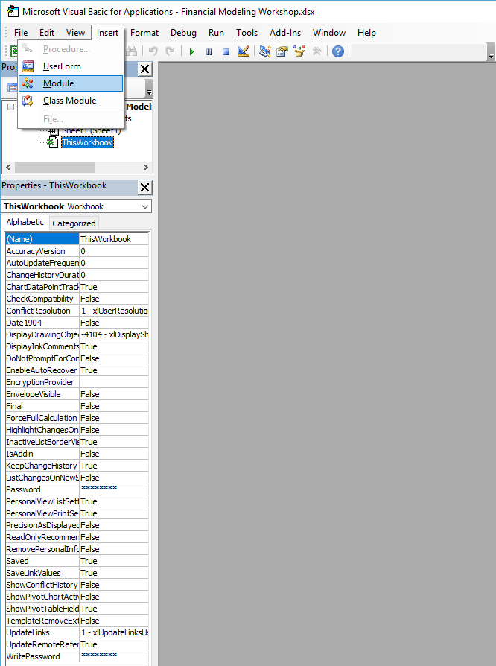
We’re not going to cover the entirety of VBA programming, but will work with the basics
We want to ensure that we are looking at the correct VBAProject.
The project name is the name of the Excel File that you are working within. In this case, it is called: “Financial Modeling Workshop.”
We will begin by inserting a module.

Slide 15
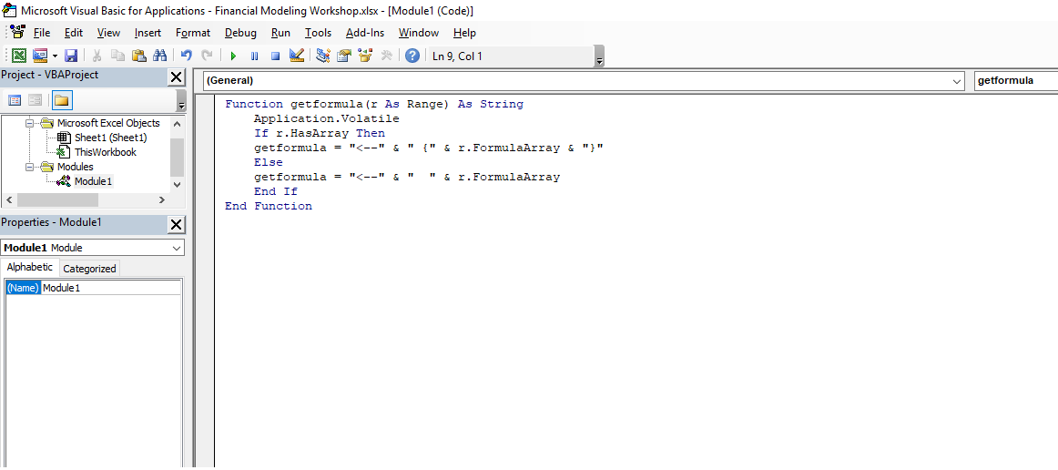
Let’s start by writing a function.
The function most commonly used in Financial Modeling is known as “getformula.” It simply tells us what
formula we plugged into any given cell, but… excel does not have this built in, so we have to code it.
This function is recalculated when any given cell in any workbook in the application window changes value
Now that we’ve written the basic “getformula” function, we can now close out of the VBA editor; this will take us back to the Excel file.
If the range (r) has an array, then the formula (getformula) = the following…

